Slide 2
HTTP/2 goals
HTTP/2 supports all core features of HTTP/1.1 but more efficient
Improve end-user quality of experience (latency)
Address head-of-line blocking
Avoid multiple connections
Retain the semantics of HTTP/1.1

Slide 3
HTTP/2 primary features
Minimize protocol overhead via efficient compression of HTTP header fields,
Server push.
Reduce latency by enabling full request and response multiplexing;
Support for request prioritization

Slide 4
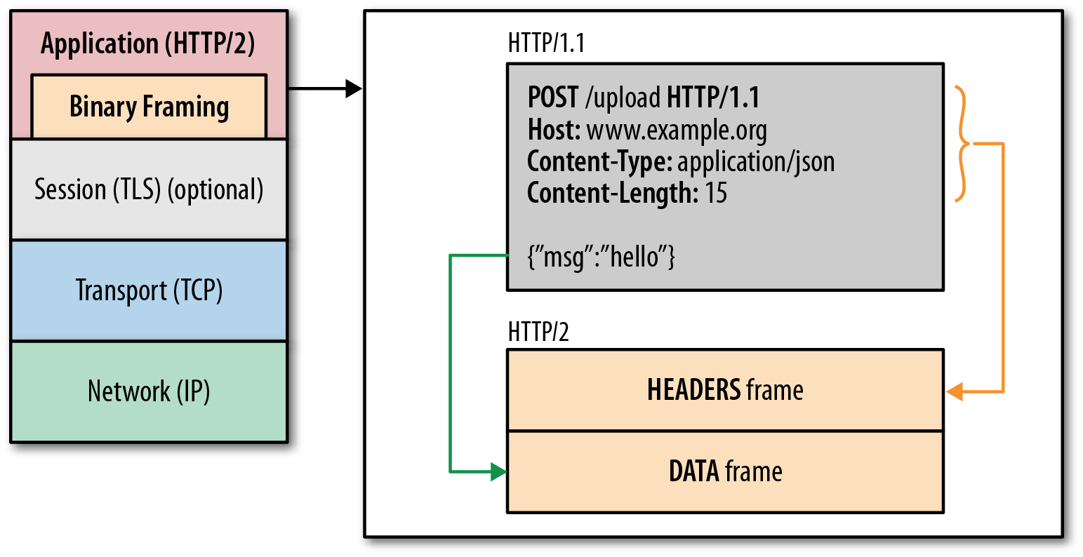
HTTP/2 features
One TCP connection
Request → Stream
Streams are multiplexed
Streams are prioritized
Binary framing layer
Prioritization
Flow control
Server push
Header compression (HPACK)
Frame - the smallest unit of communication in HTTP/2, each containing a frame header, which at a minimum identifies the stream to which the frame belongs.
Message - is a logical HTTP message, such as a request, or response consisting of of one or more frames.
Stream - a bidirectional flow of bytes within an established connection, which may carry one or more messages.

Slide 5
HTTP/2 main features cont.
Each request/response exchange is a stream.
Streams are multiplexed in the same TCP connection
(Blocked request/response does not prevent progress on other streams.)
Frame is a basic protocol unit. Two basic frame types:
1) HEADERS and DATA frames of request/responses.
2) Service frames: SETTINGS, WINDOW_UPDATE, PUSH_PROMISE
Flow control ensures that only data that can be used by a receiver is transmitted.
Server Push tradeoffs some network usage against a potential latency gain.
Frame compression HPACK

Slide 6
HTTP/2 binary framing
HTTP messages are decomposed into one or more frames
HEADERS for meta-data
DATA for payload
RST_STREAM to cancel
...
Each frame has a common header
9-byte, length prefixed
Easy and efficient to parse

Slide 7
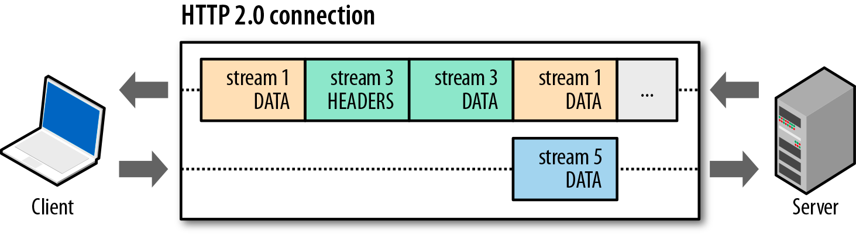
Basic data flow in HTTP 2.0
Streams are multiplexed because frames can be interleaved
All frames (e.g. HEADERS, DATA, etc) are sent over single TCP connection
Frame delivery is prioritized based on stream dependencies and weights
DATA frames are subject to per-stream and connection flow control

Slide 8
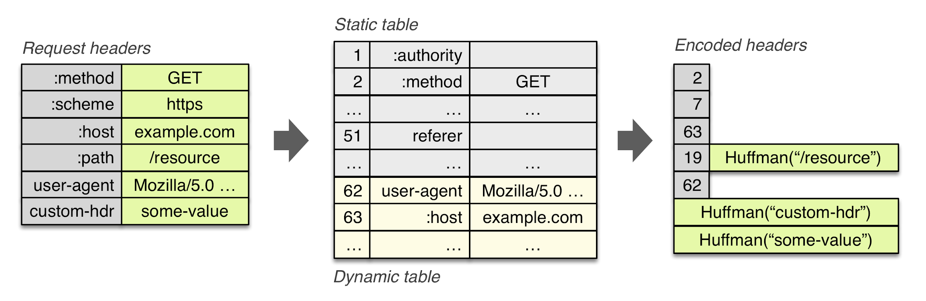
HPACK header compression
Literal values are (optionally) encoded with a static Huffman code
Previously sent values are (optionally) indexed
e.g. “2” in above example expands to “method: GET”

Slide 9


Server PUSH: because you’ll also need…
GET /product/123
Server: “You asked for /product/123, but you’ll need app.js, product-photo-1.jpg, as well… I promise to deliver these to you. That is, unless you decline or cancel.”
/product/123
/app.js
/product-photo-1.jpg
Delivers granular resources, which can be cached individually
Delivers granular resources, which can be mux’ed and prioritized correctly
Allows the client to opt-in / opt-out and control how and where it is used
Server push is subject to flow control - e.g. “you can only push 5KB”
Server push is optional and can be disabled by the client

Slide 10
Per-stream flow control + server push
Client: “I want first 20KB of photo.jpg”
Server: “Ok, 20KB… pausing stream until you tell me to send more.”
Client: “Send me the rest now.”
GET /product-photo.jpg
/product-photo.jpg
WINDOW_UPDATE
/product-photo.jpg
I want image geometry and preview, and I’ll fetch the rest later...
Flow control allows the client to pause stream delivery, and resume it later
Flow control is a “credit-based” scheme
Sending DATA frames decrements the window
WINDOW_UPDATE frames update the window
http://chimera.labs.oreilly.com/books/1230000000545/ch12.html#_flow_control

Slide 11

You... need to think about prioritization
with HTTP/2 the browser is relying on the server to deliver data in an optimal way -- this is critical.

Slide 12
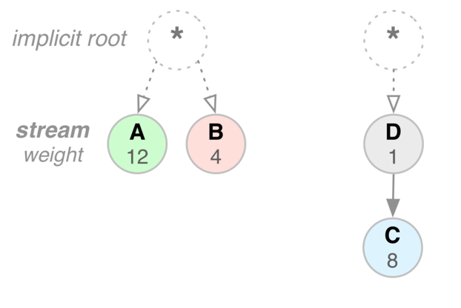
Stream prioritization in HTTP/2
Each stream can have a weight
[1-256] integer value
Each stream can have a dependency
parent is another stream ID
E.g. style.css (“A”) should get 3/4’th of available resources as compared to logo.jpg (“B”)
E.g. product-photo-1.jpg (“D”) should be delivered before product-photo-2.jpg (“C”)
* Prioritization is an advisory hint to the server, it does not provide strict delivery semantics.

Slide 13

Read it online (free):
hpbn.co/http2

